Slide 1

Who eats the food we grow?

Slide 2
Overview
The dataset
Patterns in the data
Global trend
Food vs Feed
Top 10 producing areas
Break down of top food producer products
Interesting outlier example
Conclusions

Slide 3
The dataset
The world’s population is growing - how are we are going to feed this growing population?
Worldwide distribution of food and feed between 1961-2013
Data provided by the Food and Agriculture Organisation of the United Nations (published on Kaggle)
21477 records from 174 areas/regions
Food and feed production by country and food item (1000 tonnes)
2 main production categories:
Food – total amount of food items available as human food (for local consumption)
Feed – total amount of food available for feeding livestock and poultry
Notes:
The world’s population size is increasing so it has now become a very hot topic on how we are going to feed everyone and account for this population growth.
This dataset looks at food and feed being produced around the world and is collected by the United Nations, food and agricultural organization
It contains 21477 food and feed records from 174 regions/ares – recorded in 1000s of tonnes produced
There are 2 main categories:
Food – the total amount of food for human consumption
Feed – total amount of animal feed for feeding livestock and poultry

Slide 4
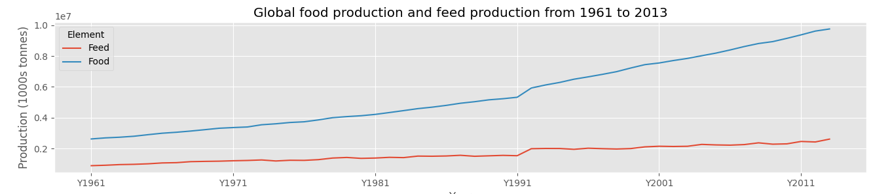
Global trend 1961-2013
Global increase in food and feed production
Food appears to have a larger increase than feed
Notes:
First thing I looked at was the global total production of food and feed. You can see that the food and feed production is increasing over time. However, the feed production has not increased as much as the food production has

Slide 5
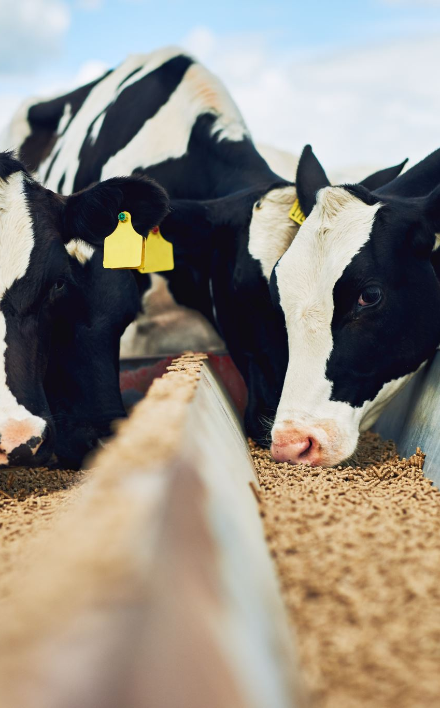
Why?
Population increasing
3 billion in 1961
7 billion in 2013
More people = more food = more animal production = more animal feed
Breeding programmes for more efficient producers
Animals that eat less feed to produce more will be selected for breeding
Higher production of plant-based foods?
9 billion by 2050
Feed accounts for up to 70% of total livestock operation costs
Concerns about effects of production of animal feed on climate
Notes:
Why are we seeing these trends?
Global population increasing
Why is feed production not increasing at same rate as food production?
Farmers always looking to breed animals that produce more milk/meat etc for less cost
Experts say we will need to double crop production by 2050

Slide 6
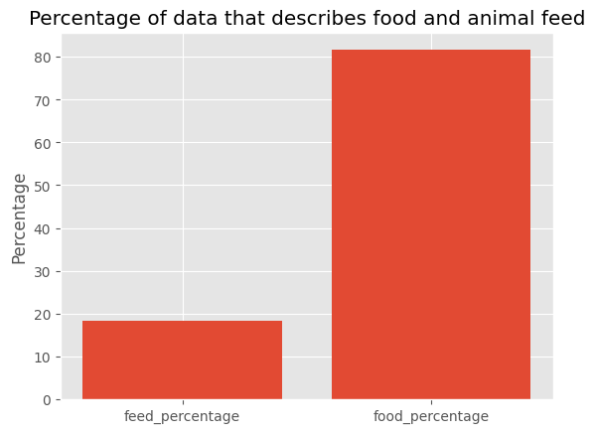
More food data in the data set
Food made up 82% of the dataset
Feed records made up 18% of the dataset
Seems reasonable as:
4 billion tonnes of food produced worldwide per year (2020)
1 billion tonnes of animal feed produced worldwide per year (2020)
Notes:
There is more data on food than on feed in this dataset
We produce more food globally per year – with ~4 billion tonnes food vs 1 billion tonnes feed per year in 2020.
So, this difference looks to be expected.
The other thing that could be happening is that food is a highly regulated industry and probably maintains good records
The feed industry may not always have everything recorded – possibly some information is missing

Slide 7
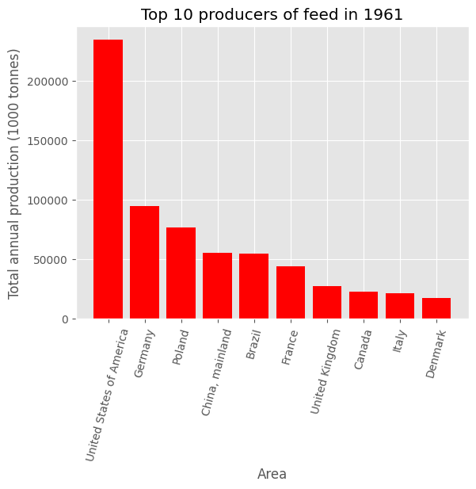
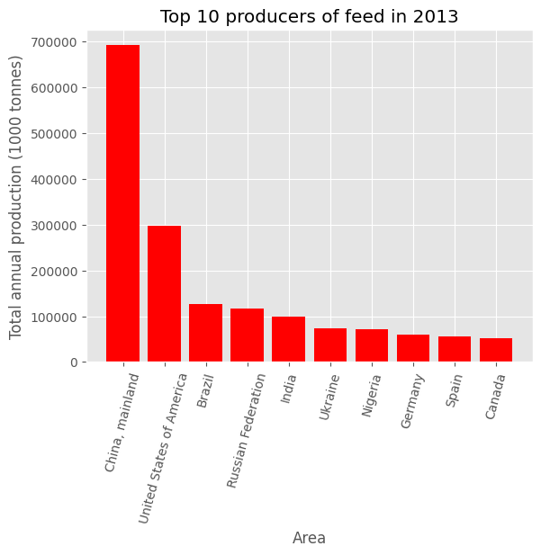
Top 10 producers - Feed
Notes:
The top producers of feed have changed between 1961 and 2013.
US biggest in 1961
China biggest in 2013
Total production of food and feed can be seen to have increased significantly during this time (~50 years) – see y-axis numbers

Slide 8
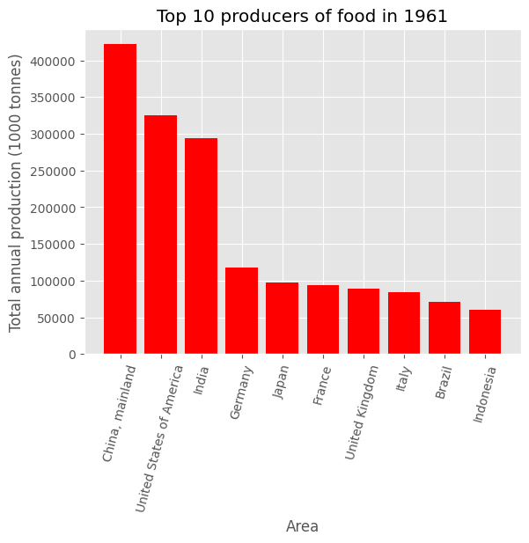
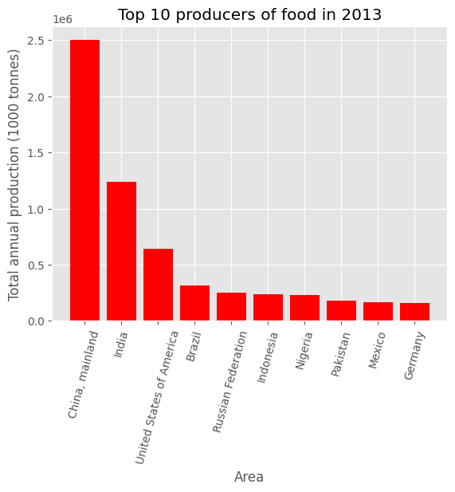
Top 10 producers - Food
Notes:
China was largest food producer in 1961 and still is now in 2013 but has become more dominant as produces significantly more food than the other big producers
Total production of food and feed can be seen to have increased significantly during this time (~50 years) – see y-axis numbers
Food – 4 hundred thousand to 2.5 mill

Slide 9
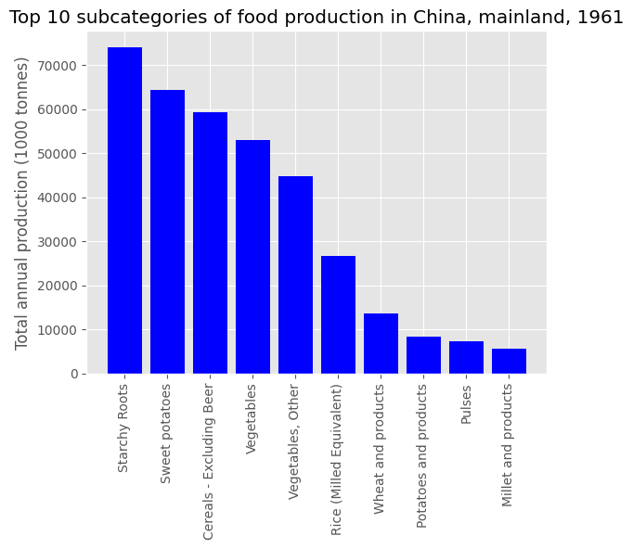
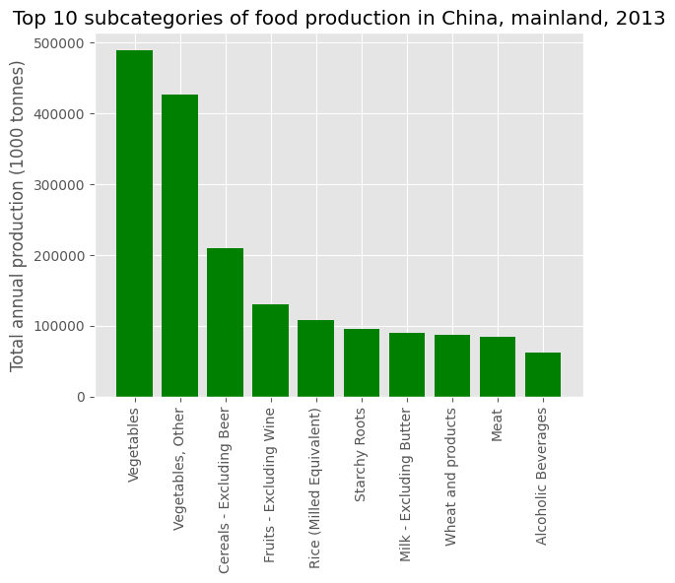
What does the top producer make the most of?
Notes:
China was top food producer in 1961 and 2013 but the kind of foods they produced the most of has changed
Why?
In 2012 china became the worlds largest grocery retail market.
The food habits of people in China has changed a lot during this time period. Shaped by urbanization, ability to order food online, so many options.
Moving away from cooking at home
1961 – the end of the great Chinese famine - china’s agricultural crisis and famine (1959 – 1961)
China took a big leap forward in agricultural production by using collectivization of agriculture – peasant households were forced to consolidate into working on collective farms
at this time which unfortunately led to severe famine

Slide 10
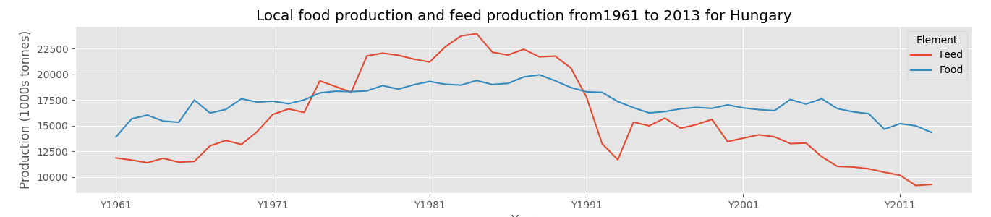
Outliers - Hungary
Major economic growth in agriculture under socialist government - 1970s
Hungarian reforms of the 1980s
1990-1991 soviet army left - saw large changes to their agricultural system
Notes:
A small number of countries had a different trend over time
Show them notebook and what you did
Then answer
Why?
Hungary – went through major economic growth in 1970s in terms of agriculture – development of large up to date farms under socialist government.
Hungarian reforms of the 1980s
Hungary produces it’s own food
1990s Hungary's agricultural system
Other outliers include:
Poland
Guyana
Cyprus
Cuba
Bulgaria

Slide 11
Conclusions
Globally we are seeing an increase in both food and feed production as our population increases
The world produces a lot more food than it does animal feed
The kind of foods we eat, and our eating habits have changed since the 1960s
Major events and political landscapes can majorly influence a country’s food and animal feed production
Notes:
Further questions could ask of data?
Which countries are growing fastest in terms of production and consumption?
Compare average production for each decade
Animal based products vs plant based products? – how much are we making? How has it changed?
What would be additional good predictors?
- weather data for given year
Political landscape
- Timing of major world or local events/ disasters

